Slide 1

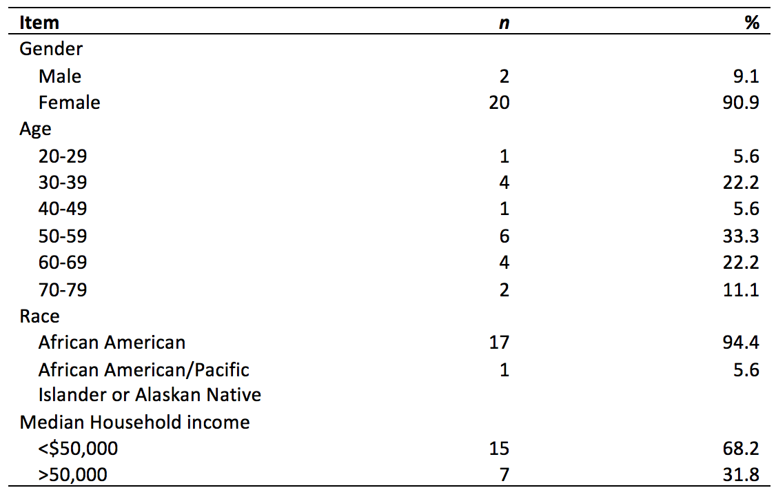
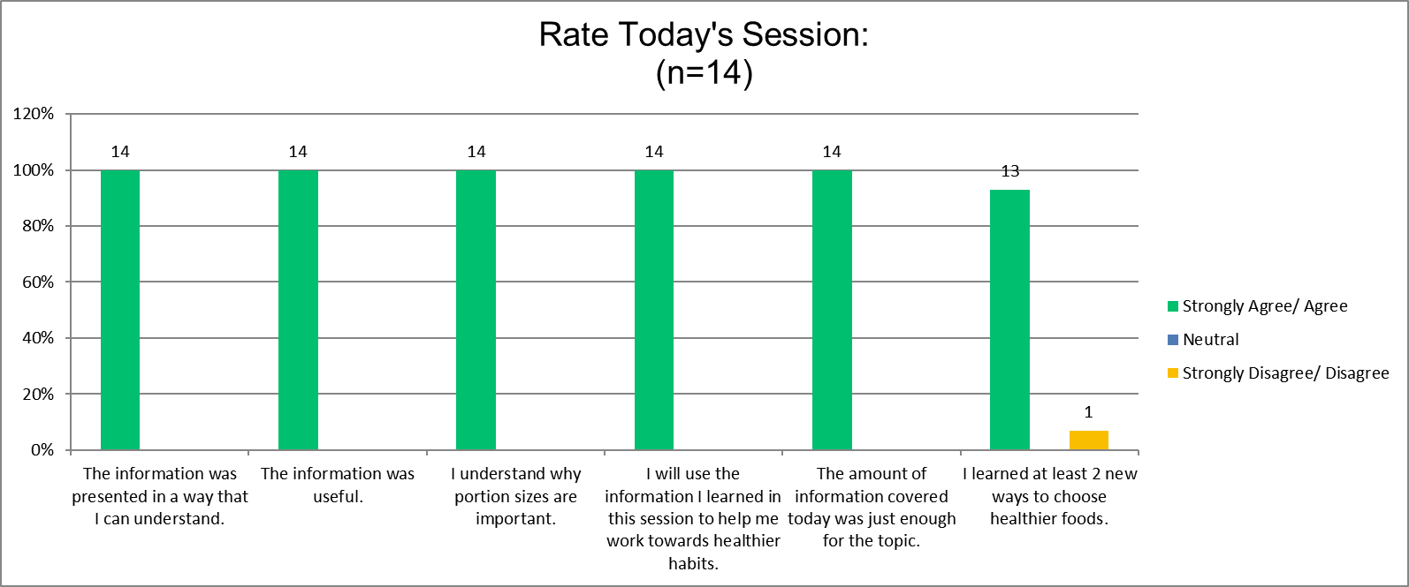
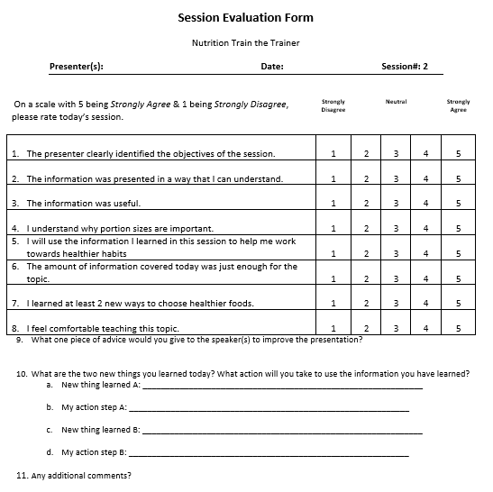
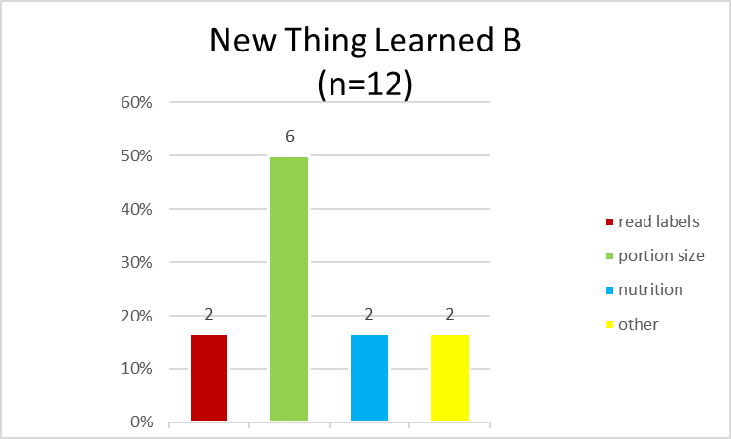
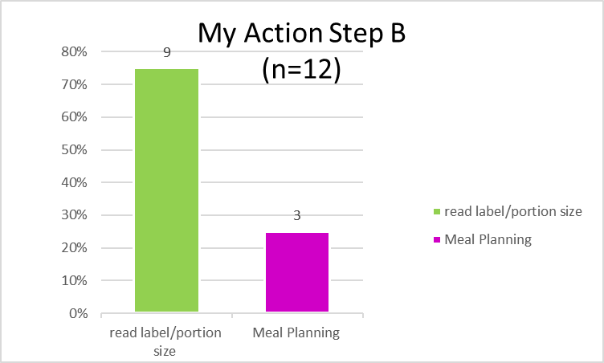
Do Right! Nutrition Train the Trainer: A Community Based Nutrition Health Education Program
Jacqueline Dowling¹, Renee Mahaffey-Harris², BA, CHES®, Rhyanne McDade², Ph.D. CHES®
1University of Cincinnati College of Medicine; 2The Center for Closing the Health Gap in Greater Cincinnati
Abstract
The Do Right! Nutrition Train the Trainer Initiative is an 8 week series designed to educate participants on the importance of nutrition, as well as equip students with the necessary skills to teach future nutrition health education programs. Nutrition Train the Trainer was developed by the Center for Closing the Health Gap (Health Gap) and is held quarterly throughout the Greater Cincinnati Area. Study Purpose: The purpose of this study was to examine the effectiveness of program delivery in a community based setting. Methods: Post-session evaluations were utilized to examine participant health knowledge and behaviors attained as a result of programming. The following items were examined in this study: (1) Participant Perception of Program Delivery and (2) New Health Knowledge/Skills Gained. Results: Participants were African American residents (N=22) who resided throughout the Greater Cincinnati Area. Participant ages ranged from 20 to 74. Post session evaluations showed substantial knowledge/skill attainment in the following areas: 1) Portion Size Control, 2.) Effective Meal Planning,3) How to Read a Nutrition Label, 4) Eating Healthy on a Budget, and 5.) Food Safety. Discussion: Program outcomes show Nutrition Train the Trainer to be an effective community based model in delivering nutrition health education. Diverse program curriculum combined with applied health education theory( Social Cognitive Theory & Health Belief Model) make this program both suitable and adaptable for most audiences. Program findings should be taken into consideration by future health educators developing nutritional programs for minority populations.
Introduction
Over 93 million (39.8%) American adults, aged 18 and older, are considered obese (Hales, Carrol, Fryar & Ogden, 2017). Obesity and overweight are both generally defined as a weight higher than normal for an individuals’ given height. More specifically, individuals who have a body mass index (BMI) exceeding 30 kg/m² are classified as obese (Centers for Disease Control and Prevention, 2017). Within the U.S. minorities exhibit the highest rates of obesity in comparison to non-Hispanic Whites. With Hispanics at 47%, followed by African Americans at 46.8% and non-Hispanic White Americans at 37.9% (American Cancer Society, 2019). Poor nutrition serves as a marker for obesity, (Rush & Yan, 2017), and as it stands, most Americans are not meeting dietary guidelines necessary to maintain optimal health (Rehm, Peñalbo, Afshin & Mozaffarian, 2016). Approximately three-fourths of Americans exhibit dietary habits low in vegetables, fruits, dairy and oils, and exceed recommendations for added sugar, saturated fats and sodium In addition, about 50% of adult Americans have one or more preventable diet-related chronic diseases, such as type 2 diabetes or cardiovascular disease (U.S. Department of Health and Human Services, 2015). As it pertains to race and social economic status, African Americans, along with other low income minority groups, are least likely to meet recommended dietary guidelines (Casagrande, Wang, Anderson & Gary, 2007). Barriers include lack of access to affordable healthy food options and lack of knowledge on how to select and prepare healthy meals (Pawlak & Colby, 2009; Drewnowski & Darmon, 2005). Research has shown there are approximately 4x the amount of grocery stores present in predominately White neighborhoods in comparison to predominately African American neighborhoods (Morland, Wind, Diez Roux & Poole, 2002). And 6x the amount of fast-food restaurants in African American communities in comparison to White communities (Block, Scribner & DeSalvo, 2004). Despite these barriers, previous studies have shown community-based health education to be an effective model to increase nutrition knowledge and positive health behaviors. In an effort to help thwart the Obesity Epidemic in the U.S., the Health Gap created a culturally competent, evidenced-based nutrition program (Do Right! Nutrition Train the Trainer) with applied health education theory (Social Cognitive Theory & Health Belief Model) to help increase nutrition knowledge and positive health behaviors in underserved populations throughout the Greater Cincinnati Area.
Results
Participant Demographics are shown in Table1. Majority of participants were African American with a median household annual income of less than $50,000.
Session 2 survey results (Figure 2) show 100% of participants indicated they strongly agree/agree they received ample knowledge on the importance of portion size/control. In addition, 93% of participants indicated they strongly agree/agree learning two new skills to identify healthy food options.
Regarding New Things Learned (Figure 3), 50% of respondents indicated learning how to identify the appropriate portion size for each food group. As a result of New Things Learned (Figure 4), over 70% of participants indicated they will now take action to read food labels in order to implement correct portion sizes throughout daily meals. Furthermore, 25% of participants indicated they will now incorporate advanced meal prep to ensure healthy food choices are available throughout the day.
Conclusion
Post session evaluations show substantial knowledge/skill attainment in the following areas: 1) Portion Size Control, 2.) Effective Meal Planning, 3) How to Read a Nutrition Label, 4) Eating Healthy on a Budget, and 5.) Food Safety. As a result of program completion, participants are now equipped with the knowledge and skills necessary to accurately read nutrition labels, enabling them to make healthier food choices. In addition, participants were able to identify proper portion sizes needed daily for each food group. Thus, providing participants with knowledge and skills necessary to better meet recommended U.S. dietary guidelines. In a study conducted by Resincow et al. 2004, results showed participants receiving health education on portion size control, increased fruit and vegetable consumption. Thus, showing the importance of education on portion size control. Participants also learned how to select heathy food options while on a budget. In comparison to other community based nutrition programs, teaching participants how to shop on a budget was not readily identified as part of program curriculum. However, for our program this skill was essential for our population, as low-income minority populaces often struggle with cost and lack of access to healthy food choices. As it pertains to health behavior theory, Nutrition Train the Trainer also incorporated both Social Cognitive Theory & Health Belief Model (Bandura, 2004; Glanz, Rimer, Viswanath & Orleans, 2008) into program development. Examination of other nutrition programs targeted towards African Americans showed absence of health behavioral theory; Inclusion may have proven beneficial for program outcomes (Lemacks, Wells, Ilich & Ralston, 2013). Overall, program outcomes show Nutrition Train the Trainer to be an effective community based model in delivering nutrition health education. Its diverse program curriculum combined with applied health education theory make this program both suitable and adaptable for most audiences. Program findings should be taken into consideration by future health educators developing nutritional programs for minority populations.
Recommendations for Future Research
Going forward, following program completion, post-session analysis should be conducted to examine participant health knowledge and behaviors. In addition to this, pre and post session biometrics may offer further insight into participant health improvement as a result of program completion. It could also be beneficial to assess whether participants chose to share their knowledge with their communities, as the class was designed to empower them to do so. Including these components will help to further refine program outcomes and improve participant health behaviors.
Table 1. Demographic and background characteristics.
References
American Cancer Society. Cancer Facts & Figures for African Americans 2019-2021. Atlanta: American Cancer Society, 2019. https://www.cancer.org/content/dam/cancer-org/research/cancer-facts-and-statistics/cancer-facts-and-figures-for-african americans/cancer-facts-and-figures-for-african-americans-2019-2021.pdf
Bandura, A. (2004). Health Promotion by Social Cognitive Means. Health Education & Behavior,31(2), 143-164. doi:10.1177/1090198104263660
Block, J. P., Scribner, R. A., & DeSalvo, K. B. (2004). Fast food, race/ethnicity, and income: A geographic analysis. American Journal of Preventative Medicine,27(3), 211-217. https://doi.org/10.1016/j.amepre.2004.06.007
Casagrande, S. S., Wang, Y., Anderson, C., & Gary, T. L. (2007). Have Americans Increased Their Fruit and Vegetable Intake? The Trends Between 1988 and 2002. American Journal of Preventive Medicine,32(4), 257-263. doi:10.1016/j.amepre.2006.12.002
Drewnowski, A., & Darmon, N. (2005). The economics of obesity: Dietary energy density and energy cost. The American Journal of Clinical Nutrition,82(1). doi:10.1093/ajcn.82.1.265s
Defining Adult Overweight and Obesity | Overweight & Obesity | CDC. (2017, April 11). Retrieved from https://www.cdc.gov/obesity/adult/defining.html
Glanz, K., Rimer, B. K., Viswanath, K., & Orleans, C. T. (2008). Health behavior and health education: Theory, Research and practice. San Francisco: Jossey-Bass.
Hales CM, Carroll MD, Fryar CD, Ogden CL. Prevalence of obesity among adults and youth: United States, 2015–2016. NCHS data brief, no 288. Hyattsville, MD: National Center for Health Statistics. 2017.
Lemacks, J., Wells, B. A., Ilich, J. Z., & Ralston, P. A. (2013). Interventions for Improving Nutrition and Physical Activity Behaviors in Adult African American Populations: A Systematic Review, January 2000 Through December 2011. Preventing Chronic Disease,10. doi:10.5888/pcd10.120256
Morland, K., Wing, S., Roux, A. D., & Poole, C. (2002). Neighborhood characteristics associated with the location of food stores and food service places. American Journal of Preventive Medicine,22(1), 23- 29. doi:10.1016/s0749-3797(01)00403-2
Pawlak, R., & Colby, S. (2009). Benefits, barriers, self-efficacy and knowledge regarding healthy foods; perception of African Americans living in eastern North Carolina. Nutrition Research and Practice,3(1), 56-63. doi:10.4162/nrp.2009.3.1.56
Rehm, C. D., Peñalvo, J. L., Afshin, A., & Mozaffarian, D. (2016). Dietary Intake Among US Adults, 1999-2012. Jama,315(23), 2542. doi:10.1001/jama.2016.7491
Resnicow, K., Campbell, M. K., Carr, C., Mccarty, F., Wang, T., Periasamy, S., . . . Stables, G. (2004). Body and soul. American Journal of Preventive Medicine,27(2), 97-105. doi:10.1016/j.amepre.2004.04.009
Rush, E., & Yan, M. (2017). Evolution not Revolution: Nutrition and Obesity. Nutrients,9(5), 519. doi:10.3390/nu9050519
U.S. Department of Health and Human Services and U.S. Department of Agriculture. 2015–2020 Dietary
Guidelines for Americans. 8th Edition. December 2015. Available at http://health.gov/dietaryguidelines/2015/guidelines/.
Methods
Participants
Participants in this study were African American (N=22) residents from the Greater Cincinnati Area.
Recruitment strategies included direct door-to-door canvassing and event promotion on the Health Gap’s social media platforms( i.e. Eventbrite, Facebook, Instagram, Twitter, and organizational website). Initiative recruitment began approximately 45 days before program commencement.
Instrumentation
Post-session evaluations were utilized to examine participant perceptions regarding course quality, as well, program knowledge and health behaviors/skills attained following program completion.
Participation was voluntary, and all survey responses were anonymous.
Procedures
Do Right! Nutrition Train the Trainer (NTT) program development and implementation was approved by the Health Gap. NTT was an eight week initiative held weekly with two-hour sessions. Assessment of program quality was performed weekly via post-session evaluations.
Prior to survey administration participants were informed of program purpose, voluntary nature of the survey, and its confidentiality. Once surveys were completed, surveys were provided to office staff and sent out for data analysis.
IRB Approval
IRB approval was not required, as this was deemed as a quality improvement study, as per U.S. Department of Health and Human Services guideline 45 CRF.46.102(d).
Data Analysis
Descriptive Data analysis was utilized to perform frequency distribution (i.e. mean, median, mode, etc.). Microsoft Excel 2016 Version 16.0.6741.2048 was utilized.
Percents denote valid percents. Missing values excluded; N=22
Figure 2. Results of the Rate Today’s Session (Session 2).
Figure 3. New Things Learned in Session 2. Figure 4. My Action Steps following Session 2..
Acknowledgements
I would like to thank the Health Gap for allowing me the opportunity to complete this community health project. I would also like to thank my intern preceptor Renee Mahaffey Harris and Rhyanne McDade for their assistance in helping me to finalize this project. And to Health Gap Team for all of their support!
Figure 1. Session 2 post-survey.

